Slide 1


Building Meaningful Employment Environments™
© 2023: Confidential and Proprietary: Meaningful Employment Environment ™ is a trademark of TrailPaths Inc.

Slide 2
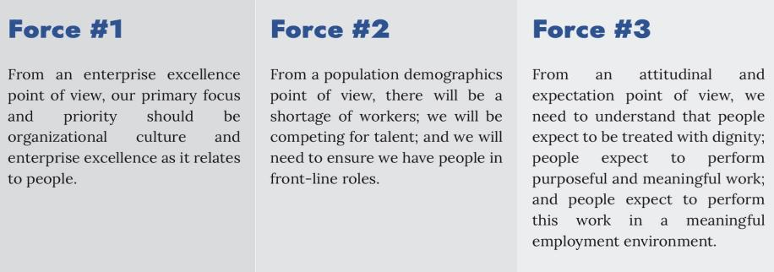
Macro Trends (Forces) On Our Doorstep
Approx. Numbers 2023: USA Population 332 M : USA Labor Force 160M : Labor Force $/Hour 80M
Planned
GDP
Aging
Population
Birth
Rates
Labor
Participation
Skills
Gap
College
Education
Legal
Immigration
Productivity
Net Tech Jobs
Attitudinal
Shifts
In addition to decades of learning from our Enterprise Excellence work, we know that People and Culture drive everything …

Slide 3
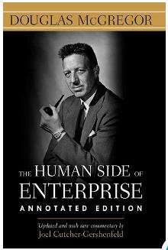
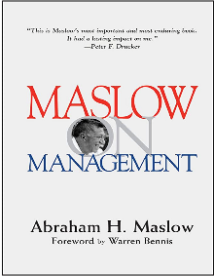
Our Personal Beliefs are a Starting Point
“…most of us would argue that we believe in the potential of people and that people are our most important organizational assets. If that is the case, why then do we frequently design organizations to satisfy our need for control and not to maximize the contributions of people? For centuries, human nature has been sold short.”

Slide 4


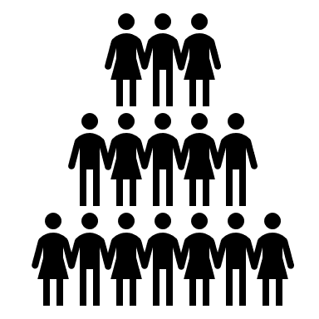



Culture = An Intentional Natural Ecosystem
This is a New Feedback Loop
Environment
100% Interdependencies
Cause and Effect Unclear
Self - Fulfilling Prophecies
Attitudes
Attitudes
Beliefs
Decisions
Beliefs
Participation
Organizational Decisions
Attitudes
Team Member Participation
Beliefs
Behaviors
Leadership Behaviors

Slide 5
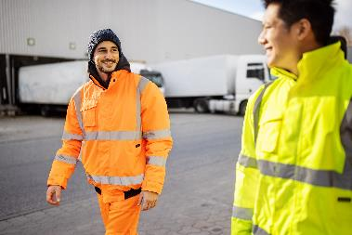


What is a Meaningful Employment Environment (MEE)
The Good News - Bad News: A MEE is different depending on the person.
The Good - Good News: There are “MEE factors” we can organize ourselves around.
This is the work we are doing … so what have we learned?

Slide 6
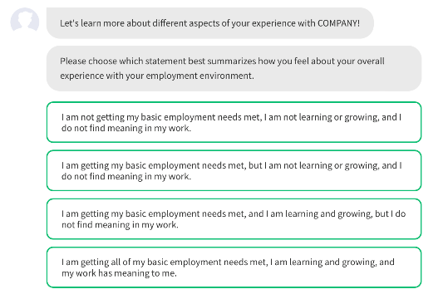
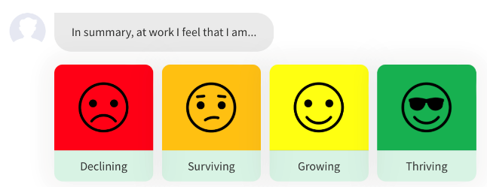
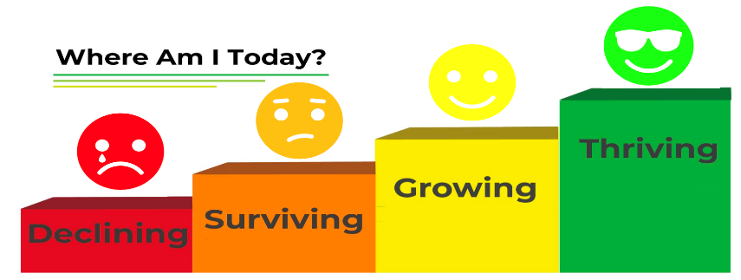
MEE Point 1: People are in One of Four Places

Slide 7
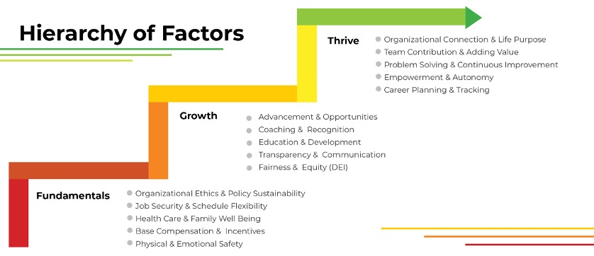
MEE Point 2: MEE Organizational Decision Factors

Slide 8
MEE: The Business System

Slide 9
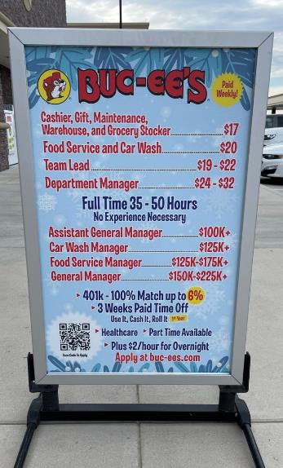
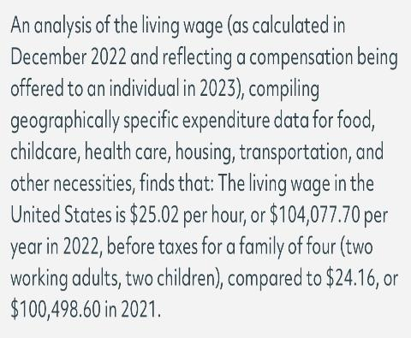
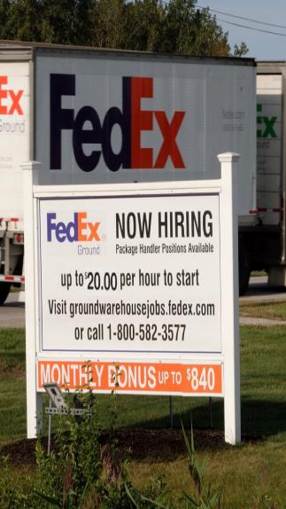
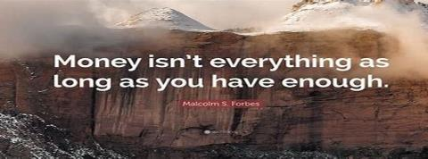
Fact or Fiction : Money is not a primary motivator ?

Slide 10
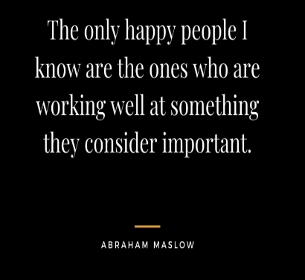
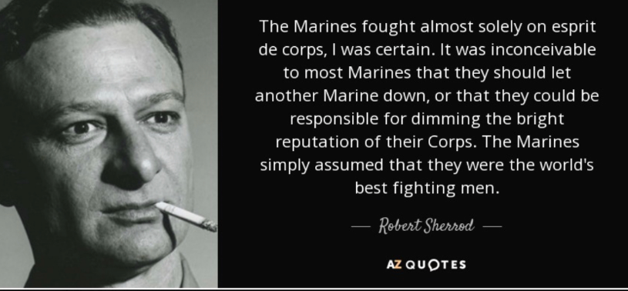
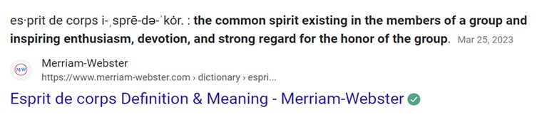
Who’s Going to Build the Community ?

Slide 11
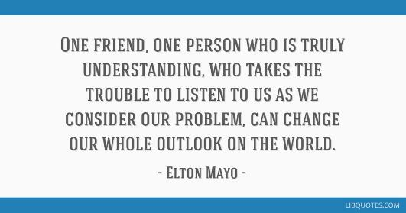
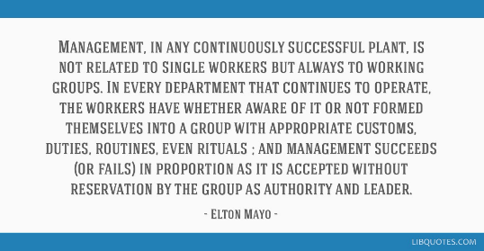
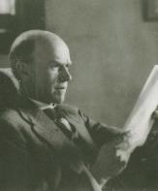
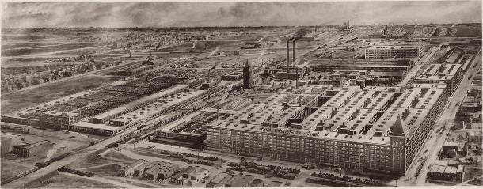
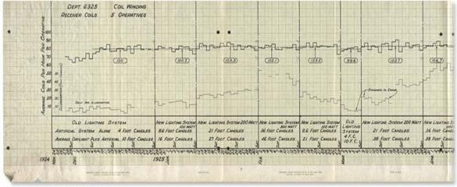
The Hawthorne Studies : The Lessons Learned
Elton Mayo – Fritz Roethlisberger: Western Electric Company, Hawthorne Works of Illinois.: 1924-1932

Slide 12
Dignity: Leaders Create the Environment
Know Each Other
Past Experience
Present Situation
Understand Each Other
Strengths
Weaknesses
Improve Each Other
Teach
Learn
Future Aspirations
Opportunities
Grow
MEE Leadership Behaviors Dignity
Dignity: Treat people with value and respect for no other reason than they are a human being and have fundamental needs.

Slide 13
Meaningful Work: Leaders Create the Environment
Know the Work
Make Work Visible
Know the Value
Understand the Work
Work Design
Work Knowledge
Improve the Work
Opportunity Prioritization
Obstacle Removal
Know the Obstacles
Work Flow
Team Celebration
MEE Leadership Behaviors Meaningful Work
MW: Ensure that work is safe, purposeful, valuable, free of obstacles (waste), growth oriented, challenging and provides for learning.

Slide 14
Rating the Factors
Strong Disagreement
Strong Agreement
Factor Question Responses
D.2.T Implications
Declining
Surviving
Growing
Thriving
MEE Factor Rating Category
Threatening
Stable
Meaningful

Slide 15
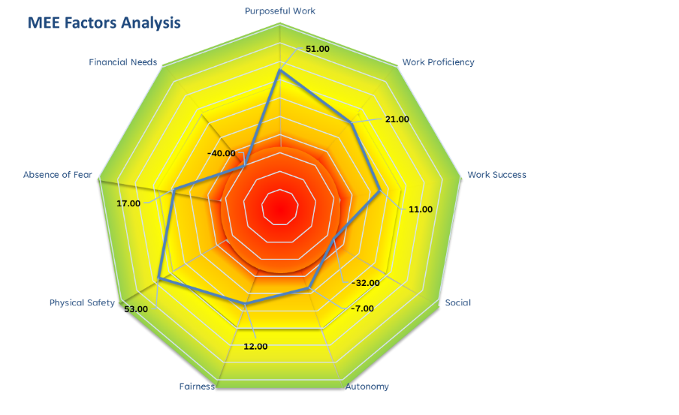
Meaningfulness Factor Summary
The Work
Most Meaningful
+100
The Fundamentals
-100
Most Threatening
The Work Environment

Slide 16
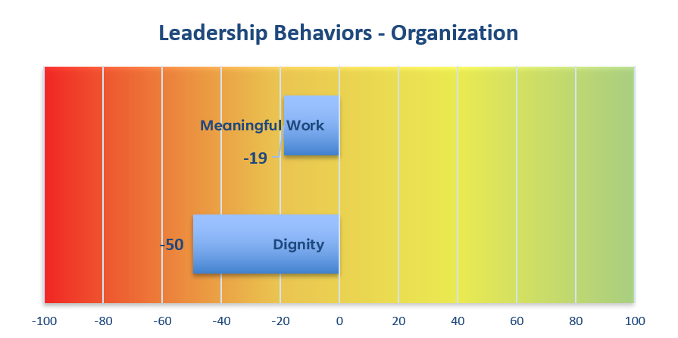
Leadership Behaviors Summary
Most Threatening
Most Meaningful

Slide 17
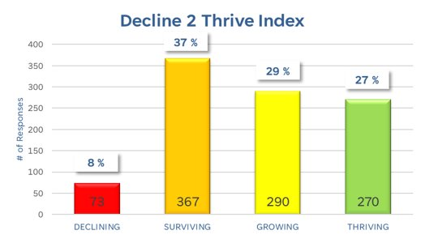

Decline 2 Thrive
Declining & Surviving Responses:
440 (45%) indicate threats to leave the organization

Slide 18
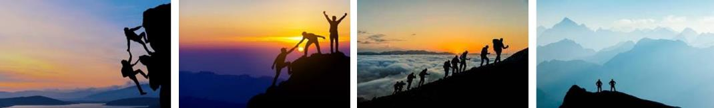
MEE : If Not Forward… Then Backward
Gravity and Entropy are Natural Forces Trying to Take Us Back…
“Darkness has a hunger that’s insatiable…” Indigo Girls
Decline
Survive
Grow
Thrive
Know Me
Understand Me
Improve Me
& I’ll Advance Myself
…The Only Option is Intentional Continuous Movement Forward
“Everybody has a hungry heart…” Bruce Springsteen

Slide 19
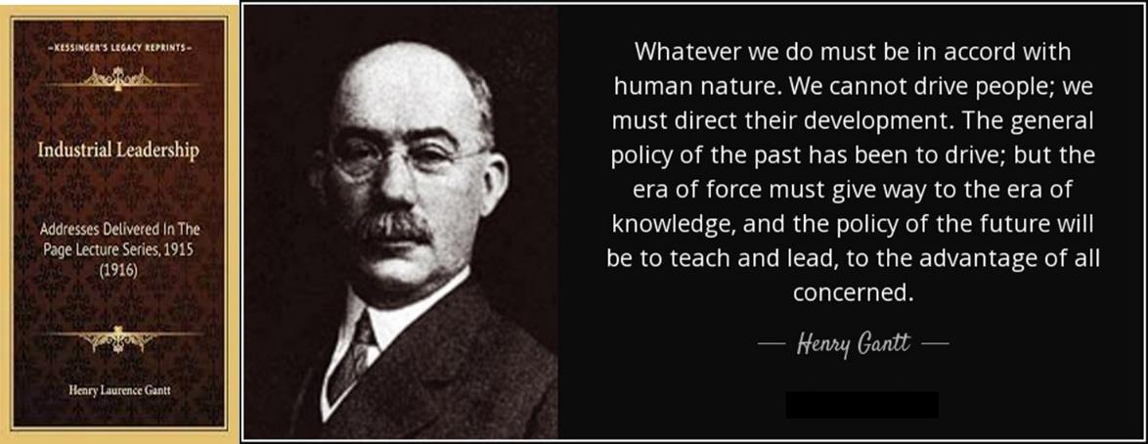

Slide 20
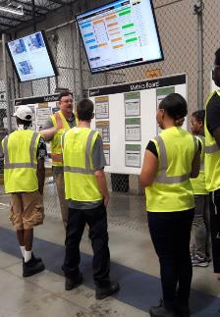
Our Personal Beliefs & Organizational Decisions

Slide 21
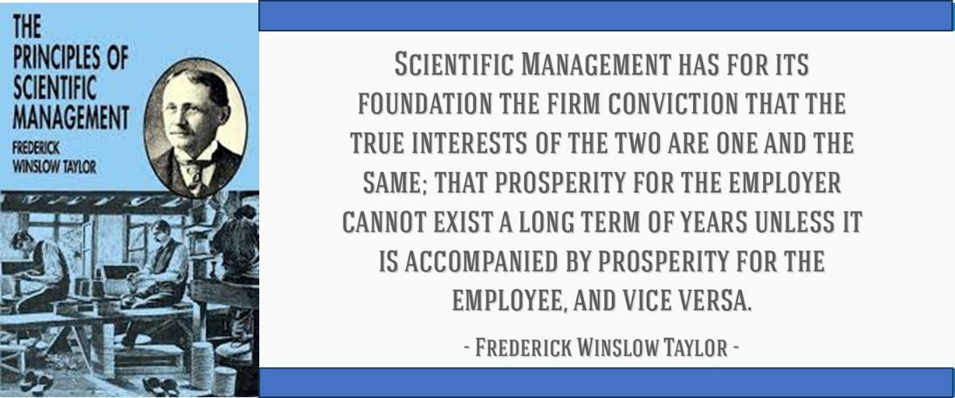

Slide 23
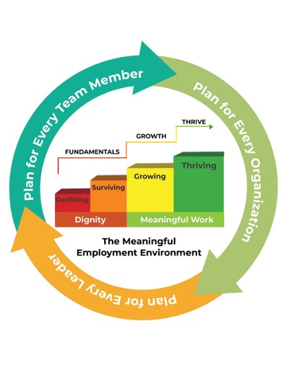
The Path Forward
Purpose: To build a Meaningful Employment Environment (MEE) from the perspective of the organization, leadership and all team members. This work results in the creation of three specific paths forward, a plan for:
Organizational Decisions:
How do we build the environment, so leaders and team members have everything needed to be successful?
Leadership Behaviors:
How will we develop people to lead with dignity and support their teams as they make the work more meaningful?
Team Member Participation:
How will we garner the trust of team members so that they participate, learn and grow, perpetuating the meaningful work environment?

Slide 24
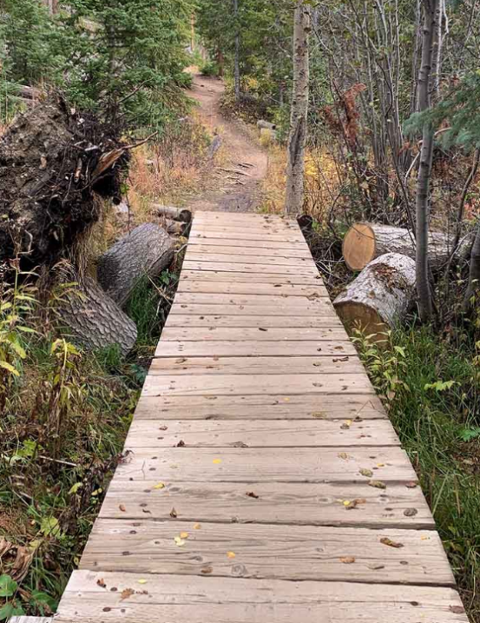
Summary & Call to Action
Workforce dynamics are changing fast…
People have choices…
People want and deserve better…
A Meaningful Employment Environment is built by being intentional about:
  Organizational Decisions
  Leadership Behaviors
  Team Member Participation
Dignity & Meaningful Work
Let’s do something about it!

Slide 25
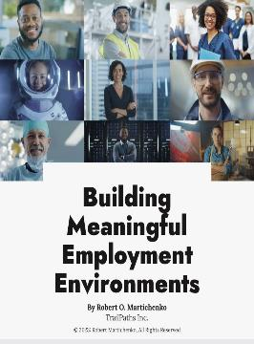
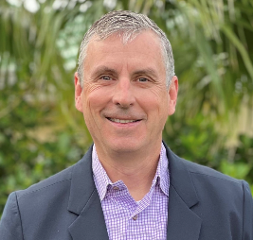
Thank You
Advancing Employment Environments
Advancing People
Robert Martichenko
Robert@TrailPaths.com

