Slide 1


The World Is Flat, Except When It Isn’t:
The Ying and Yang of Globalization and Deglobalization
Presented by: James A. Tompkins, Ph.D.
Founder and Chairman, Tompkins Ventures
Date: October 11, 2023
Conference/Event: Keller Logistics Summit

Slide 2
Disclaimer
All the information in this presentation is the result of Tompkins Venture’s research of public information.
There is no information being presented today that comes from any proprietary source.
Tompkins Ventures does not discuss information about their clients unless that information has been published.
2

Slide 3

Yin and Yang
A Chinese philosophical concept that describes how opposite or contrary forces actually may be complementary, interconnected and interdependent.
Yin is the receptive and Yang the active:
Is about duality and acting complementary (rather than acting as opponents).
A balance between two opposites: When one reaches its peak, it will transform into the other.
* Winter & Summer | * Dark & Light
* Negative & Positive | * Female & Male
* Wet & Dry | * Earth & Heaven
3

Slide 4
Yin and Yang
A Chinese philosophical concept that describes how opposite or contrary forces actually may be complementary, interconnected and interdependent.
Yin is the receptive and Yang the active:
Is about duality and acting complementary (rather than acting as opponents).
A balance between two opposites: When one reaches its peak, it will transform into the other.
* Winter & Summer | * Dark & Light
* Negative & Positive | * Female & Male
* Wet & Dry | * Earth & Heaven
3

Slide 5
Yin and Yang
A Chinese philosophical concept that describes how opposite or contrary forces actually may be complementary, interconnected and interdependent.
Yin is the receptive and Yang the active:
Is about duality and acting complementary (rather than acting as opponents).
A balance between two opposites: When one reaches its peak, it will transform into the other.
* Winter & Summer | * Dark & Light
* Negative & Positive | * Female & Male
* Wet & Dry | * Earth & Heaven
3

Slide 6
Yin and Yang
A Chinese philosophical concept that describes how opposite or contrary forces actually may be complementary, interconnected and interdependent.
Yin is the receptive and Yang the active:
Is about duality and acting complementary (rather than acting as opponents).
A balance between two opposites: When one reaches its peak, it will transform into the other.
* Winter & Summer | * Dark & Light
* Negative & Positive | * Female & Male
* Wet & Dry | * Earth & Heaven
3

Slide 7
Yin and Yang
A Chinese philosophical concept that describes how opposite or contrary forces actually may be complementary, interconnected and interdependent.
Yin is the receptive and Yang the active:
Is about duality and acting complementary (rather than acting as opponents).
A balance between two opposites: When one reaches its peak, it will transform into the other.
* Winter & Summer | * Dark & Light
* Negative & Positive | * Female & Male
* Wet & Dry | * Earth & Heaven
3

Slide 8
Yin and Yang
A Chinese philosophical concept that describes how opposite or contrary forces actually may be complementary, interconnected and interdependent.
Yin is the receptive and Yang the active:
Is about duality and acting complementary (rather than acting as opponents).
A balance between two opposites: When one reaches its peak, it will transform into the other.
* Winter & Summer | * Dark & Light
* Negative & Positive | * Female & Male
* Wet & Dry | * Earth & Heaven
3

Slide 9

Yin and Yang of VUCA
VUCA: Volatility, Uncertainty, Complexity and Ambiguity
Volatility: The speed and magnitude of change.
Uncertainty: The lack of predictability.
Complexity: The multiplex of forces.
Ambiguity: The haziness of reality.
VUCA: Vision → Understanding → Clarity → Agility:
Vision: A clear picture of the future.
Understanding: An appreciation of different sides of the story.
Clarity: An ability to communicate clearly.
Agility: An ability to adapt quickly.
4

Slide 10
Yin and Yang of VUCA
VUCA: Volatility, Uncertainty, Complexity and Ambiguity
Volatility: The speed and magnitude of change.
Uncertainty: The lack of predictability.
Complexity: The multiplex of forces.
Ambiguity: The haziness of reality.
VUCA: Vision → Understanding → Clarity → Agility:
Vision: A clear picture of the future.
Understanding: An appreciation of different sides of the story.
Clarity: An ability to communicate clearly.
Agility: An ability to adapt quickly.
4

Slide 11
Yin and Yang of VUCA
VUCA: Volatility, Uncertainty, Complexity and Ambiguity
Volatility: The speed and magnitude of change.
Uncertainty: The lack of predictability.
Complexity: The multiplex of forces.
Ambiguity: The haziness of reality.
VUCA: Vision → Understanding → Clarity → Agility:
Vision: A clear picture of the future.
Understanding: An appreciation of different sides of the story.
Clarity: An ability to communicate clearly.
Agility: An ability to adapt quickly.
4

Slide 12
Yin and Yang of VUCA
VUCA: Volatility, Uncertainty, Complexity and Ambiguity
Volatility: The speed and magnitude of change.
Uncertainty: The lack of predictability.
Complexity: The multiplex of forces.
Ambiguity: The haziness of reality.
VUCA: Vision → Understanding → Clarity → Agility:
Vision: A clear picture of the future.
Understanding: An appreciation of different sides of the story.
Clarity: An ability to communicate clearly.
Agility: An ability to adapt quickly.
4

Slide 13
Yin and Yang of VUCA
VUCA: Volatility, Uncertainty, Complexity and Ambiguity
Volatility: The speed and magnitude of change.
Uncertainty: The lack of predictability.
Complexity: The multiplex of forces.
Ambiguity: The haziness of reality.
VUCA: Vision → Understanding → Clarity → Agility:
Vision: A clear picture of the future.
Understanding: An appreciation of different sides of the story.
Clarity: An ability to communicate clearly.
Agility: An ability to adapt quickly.
4

Slide 14
Yin and Yang of VUCA
VUCA: Volatility, Uncertainty, Complexity and Ambiguity
Volatility: The speed and magnitude of change.
Uncertainty: The lack of predictability.
Complexity: The multiplex of forces.
Ambiguity: The haziness of reality.
VUCA: Vision → Understanding → Clarity → Agility:
Vision: A clear picture of the future.
Understanding: An appreciation of different sides of the story.
Clarity: An ability to communicate clearly.
Agility: An ability to adapt quickly.
4

Slide 15
Yin and Yang of VUCA
VUCA: Volatility, Uncertainty, Complexity and Ambiguity
Volatility: The speed and magnitude of change.
Uncertainty: The lack of predictability.
Complexity: The multiplex of forces.
Ambiguity: The haziness of reality.
VUCA: Vision → Understanding → Clarity → Agility:
Vision: A clear picture of the future.
Understanding: An appreciation of different sides of the story.
Clarity: An ability to communicate clearly.
Agility: An ability to adapt quickly.
4

Slide 16
Yin and Yang of VUCA
VUCA: Volatility, Uncertainty, Complexity and Ambiguity
Volatility: The speed and magnitude of change.
Uncertainty: The lack of predictability.
Complexity: The multiplex of forces.
Ambiguity: The haziness of reality.
VUCA: Vision → Understanding → Clarity → Agility:
Vision: A clear picture of the future.
Understanding: An appreciation of different sides of the story.
Clarity: An ability to communicate clearly.
Agility: An ability to adapt quickly.
4

Slide 17
Yin and Yang of VUCA
VUCA: Volatility, Uncertainty, Complexity and Ambiguity
Volatility: The speed and magnitude of change.
Uncertainty: The lack of predictability.
Complexity: The multiplex of forces.
Ambiguity: The haziness of reality.
VUCA: Vision → Understanding → Clarity → Agility:
Vision: A clear picture of the future.
Understanding: An appreciation of different sides of the story.
Clarity: An ability to communicate clearly.
Agility: An ability to adapt quickly.
4

Slide 18
Yin and Yang of VUCA
VUCA: Volatility, Uncertainty, Complexity and Ambiguity
Volatility: The speed and magnitude of change.
Uncertainty: The lack of predictability.
Complexity: The multiplex of forces.
Ambiguity: The haziness of reality.
VUCA: Vision → Understanding → Clarity → Agility:
Vision: A clear picture of the future.
Understanding: An appreciation of different sides of the story.
Clarity: An ability to communicate clearly.
Agility: An ability to adapt quickly.
4

Slide 19
Yin and Yang of VUCA
VUCA: Volatility, Uncertainty, Complexity and Ambiguity
Volatility: The speed and magnitude of change.
Uncertainty: The lack of predictability.
Complexity: The multiplex of forces.
Ambiguity: The haziness of reality.
VUCA: Vision → Understanding → Clarity → Agility:
Vision: A clear picture of the future.
Understanding: An appreciation of different sides of the story.
Clarity: An ability to communicate clearly.
Agility: An ability to adapt quickly.
4

Slide 20
Yin and Yang of Deglobalization and Globalization
Deglobalization is dead/alive, or Globalization is alive/dead.
Deglobalization is increasing/decreasing, or Globalization is decreasing/increasing.
Not a straightforward, one-size-fits-all scenario.
The Yin/Yang of Deglobalization and Globalization:
  Tariffs ↔ Free trade agreements.
  Business subsidies ↔ Punitive business tax policies.
  Export/import trade restrictions ↔ Export/import quotas.
5

Slide 21
Yin and Yang of Deglobalization and Globalization
Deglobalization is dead/alive, or Globalization is alive/dead.
Deglobalization is increasing/decreasing, or Globalization is decreasing/increasing.
Not a straightforward, one-size-fits-all scenario.
The Yin/Yang of Deglobalization and Globalization:
  Tariffs ↔ Free trade agreements.
  Business subsidies ↔ Punitive business tax policies.
  Export/import trade restrictions ↔ Export/import quotas.
5

Slide 22
Yin and Yang of Deglobalization and Globalization
Deglobalization is dead/alive, or Globalization is alive/dead.
Deglobalization is increasing/decreasing, or Globalization is decreasing/increasing.
Not a straightforward, one-size-fits-all scenario.
The Yin/Yang of Deglobalization and Globalization:
  Tariffs ↔ Free trade agreements.
  Business subsidies ↔ Punitive business tax policies.
  Export/import trade restrictions ↔ Export/import quotas.
5

Slide 23
Yin and Yang of Deglobalization and Globalization
Deglobalization is dead/alive, or Globalization is alive/dead.
Deglobalization is increasing/decreasing, or Globalization is decreasing/increasing.
Not a straightforward, one-size-fits-all scenario.
The Yin/Yang of Deglobalization and Globalization:
  Tariffs ↔ Free trade agreements.
  Business subsidies ↔ Punitive business tax policies.
  Export/import trade restrictions ↔ Export/import quotas.
5

Slide 24
Yin and Yang of Deglobalization and Globalization
Deglobalization is dead/alive, or Globalization is alive/dead.
Deglobalization is increasing/decreasing, or Globalization is decreasing/increasing.
Not a straightforward, one-size-fits-all scenario.
The Yin/Yang of Deglobalization and Globalization:
  Tariffs ↔ Free trade agreements.
  Business subsidies ↔ Punitive business tax policies.
  Export/import trade restrictions ↔ Export/import quotas.
5

Slide 25
Yin and Yang of Deglobalization and Globalization
Deglobalization is dead/alive, or Globalization is alive/dead.
Deglobalization is increasing/decreasing, or Globalization is decreasing/increasing.
Not a straightforward, one-size-fits-all scenario.
The Yin/Yang of Deglobalization and Globalization:
  Tariffs ↔ Free trade agreements.
  Business subsidies ↔ Punitive business tax policies.
  Export/import trade restrictions ↔ Export/import quotas.
5

Slide 26
Yin and Yang of Deglobalization and Globalization
Deglobalization is dead/alive, or Globalization is alive/dead.
Deglobalization is increasing/decreasing, or Globalization is decreasing/increasing.
Not a straightforward, one-size-fits-all scenario.
The Yin/Yang of Deglobalization and Globalization:
  Tariffs ↔ Free trade agreements.
  Business subsidies ↔ Punitive business tax policies.
  Export/import trade restrictions ↔ Export/import quotas.
5

Slide 27
Yin and Yang of Deglobalization and Globalization
Deglobalization is dead/alive, or Globalization is alive/dead.
Deglobalization is increasing/decreasing, or Globalization is decreasing/increasing.
Not a straightforward, one-size-fits-all scenario.
The Yin/Yang of Deglobalization and Globalization:
  Tariffs ↔ Free trade agreements.
  Business subsidies ↔ Punitive business tax policies.
  Export/import trade restrictions ↔ Export/import quotas.
5

Slide 28
Deglobalization and Globalization
Deglobalization is the movement toward a less integrated world, characterized by local solutions, onshoring, tariffs and border control.
Globalization is the movement toward a more integrated world with increasingly interdependent economies, cultures and populations.
Deglobalization and Globalization are Yin and Yang forces.
Deglobalization and Globalization are dynamic and diverse forces that have much in common with the weather.
Deglobalization and Globalization are in a synchronized dance as history unfolds.
Decisions about Deglobalization and Globalization have a lot to do with the costs associated with getting goods to markets.
6

Slide 29
Deglobalization and Globalization
Deglobalization is the movement toward a less integrated world, characterized by local solutions, onshoring, tariffs and border control.
Globalization is the movement toward a more integrated world with increasingly interdependent economies, cultures and populations.
Deglobalization and Globalization are Yin and Yang forces.
Deglobalization and Globalization are dynamic and diverse forces that have much in common with the weather.
Deglobalization and Globalization are in a synchronized dance as history unfolds.
Decisions about Deglobalization and Globalization have a lot to do with the costs associated with getting goods to markets.
6

Slide 30
Deglobalization and Globalization
Deglobalization is the movement toward a less integrated world, characterized by local solutions, onshoring, tariffs and border control.
Globalization is the movement toward a more integrated world with increasingly interdependent economies, cultures and populations.
Deglobalization and Globalization are Yin and Yang forces.
Deglobalization and Globalization are dynamic and diverse forces that have much in common with the weather.
Deglobalization and Globalization are in a synchronized dance as history unfolds.
Decisions about Deglobalization and Globalization have a lot to do with the costs associated with getting goods to markets.
6

Slide 31
Deglobalization and Globalization
Deglobalization is the movement toward a less integrated world, characterized by local solutions, onshoring, tariffs and border control.
Globalization is the movement toward a more integrated world with increasingly interdependent economies, cultures and populations.
Deglobalization and Globalization are Yin and Yang forces.
Deglobalization and Globalization are dynamic and diverse forces that have much in common with the weather.
Deglobalization and Globalization are in a synchronized dance as history unfolds.
Decisions about Deglobalization and Globalization have a lot to do with the costs associated with getting goods to markets.
6

Slide 32
Deglobalization and Globalization
Deglobalization is the movement toward a less integrated world, characterized by local solutions, onshoring, tariffs and border control.
Globalization is the movement toward a more integrated world with increasingly interdependent economies, cultures and populations.
Deglobalization and Globalization are Yin and Yang forces.
Deglobalization and Globalization are dynamic and diverse forces that have much in common with the weather.
Deglobalization and Globalization are in a synchronized dance as history unfolds.
Decisions about Deglobalization and Globalization have a lot to do with the costs associated with getting goods to markets.
6

Slide 33
Deglobalization and Globalization
Deglobalization is the movement toward a less integrated world, characterized by local solutions, onshoring, tariffs and border control.
Globalization is the movement toward a more integrated world with increasingly interdependent economies, cultures and populations.
Deglobalization and Globalization are Yin and Yang forces.
Deglobalization and Globalization are dynamic and diverse forces that have much in common with the weather.
Deglobalization and Globalization are in a synchronized dance as history unfolds.
Decisions about Deglobalization and Globalization have a lot to do with the costs associated with getting goods to markets.
6

Slide 34
Deglobalization and Globalization
Deglobalization is the movement toward a less integrated world, characterized by local solutions, onshoring, tariffs and border control.
Globalization is the movement toward a more integrated world with increasingly interdependent economies, cultures and populations.
Deglobalization and Globalization are Yin and Yang forces.
Deglobalization and Globalization are dynamic and diverse forces that have much in common with the weather.
Deglobalization and Globalization are in a synchronized dance as history unfolds.
Decisions about Deglobalization and Globalization have a lot to do with the costs associated with getting goods to markets.
6

Slide 35
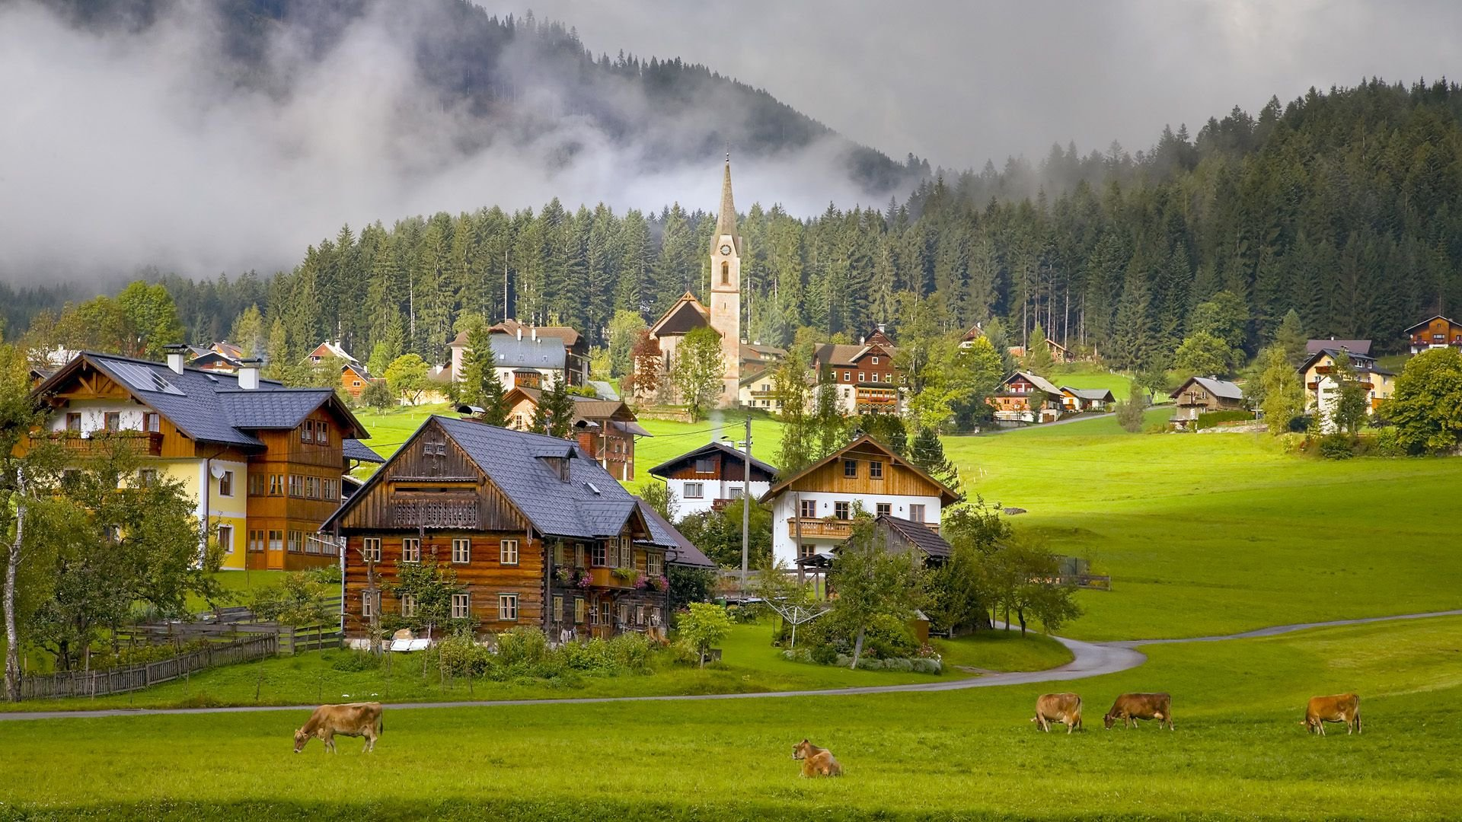
It Takes A Village: Comparative Advantage
The evolution of civilization from hunter-gatherer status to a village to a region to a country, etc., begat:
  Economies of scale,
  Improved quality of life,
  International trade and
  Increased living standards.
If left uninhibited, this evolution of civilization results in globalization and prosperity for all.
Leaving globalization uninhibited results in a level playing field and a Flat World.
7

Slide 36
It Takes A Village: Comparative Advantage
The evolution of civilization from hunter-gatherer status to a village to a region to a country, etc., begat:
  Economies of scale,
  Improved quality of life,
  International trade and
  Increased living standards.
If left uninhibited, this evolution of civilization results in globalization and prosperity for all.
Leaving globalization uninhibited results in a level playing field and a Flat World.
7

Slide 37
It Takes A Village: Comparative Advantage
The evolution of civilization from hunter-gatherer status to a village to a region to a country, etc., begat:
  Economies of scale,
  Improved quality of life,
  International trade and
  Increased living standards.
If left uninhibited, this evolution of civilization results in globalization and prosperity for all.
Leaving globalization uninhibited results in a level playing field and a Flat World.
7

Slide 38
It Takes A Village: Comparative Advantage
The evolution of civilization from hunter-gatherer status to a village to a region to a country, etc., begat:
  Economies of scale,
  Improved quality of life,
  International trade and
  Increased living standards.
If left uninhibited, this evolution of civilization results in globalization and prosperity for all.
Leaving globalization uninhibited results in a level playing field and a Flat World.
7

Slide 39
It Takes A Village: Comparative Advantage
The evolution of civilization from hunter-gatherer status to a village to a region to a country, etc., begat:
  Economies of scale,
  Improved quality of life,
  International trade and
  Increased living standards.
If left uninhibited, this evolution of civilization results in globalization and prosperity for all.
Leaving globalization uninhibited results in a level playing field and a Flat World.
7

Slide 40
It Takes A Village: Comparative Advantage
The evolution of civilization from hunter-gatherer status to a village to a region to a country, etc., begat:
  Economies of scale,
  Improved quality of life,
  International trade and
  Increased living standards.
If left uninhibited, this evolution of civilization results in globalization and prosperity for all.
Leaving globalization uninhibited results in a level playing field and a Flat World.
7

Slide 41
It Takes A Village: Comparative Advantage
The evolution of civilization from hunter-gatherer status to a village to a region to a country, etc., begat:
  Economies of scale,
  Improved quality of life,
  International trade and
  Increased living standards.
If left uninhibited, this evolution of civilization results in globalization and prosperity for all.
Leaving globalization uninhibited results in a level playing field and a Flat World.
7

Slide 42
It Takes A Village: Comparative Advantage
The evolution of civilization from hunter-gatherer status to a village to a region to a country, etc., begat:
  Economies of scale,
  Improved quality of life,
  International trade and
  Increased living standards.
If left uninhibited, this evolution of civilization results in globalization and prosperity for all.
Leaving globalization uninhibited results in a level playing field and a Flat World.
7

Slide 43

The Impact of Flatness on Competitive Advantage and Globalization
Flatness increases the size and diversity of the markets countries can address, which results in more Globalization.
Globalization reduces barriers to trade and begets free trade.
Globalization increases competition and innovation, which enhances comparative advantage.
Globalization and Deglobalization are dynamic in how they affect world events, politics and the flatness of the world.
8

Slide 44
The Impact of Flatness on Competitive Advantage and Globalization
Flatness increases the size and diversity of the markets countries can address, which results in more Globalization.
Globalization reduces barriers to trade and begets free trade.
Globalization increases competition and innovation, which enhances comparative advantage.
Globalization and Deglobalization are dynamic in how they affect world events, politics and the flatness of the world.
8

Slide 45
The Impact of Flatness on Competitive Advantage and Globalization
Flatness increases the size and diversity of the markets countries can address, which results in more Globalization.
Globalization reduces barriers to trade and begets free trade.
Globalization increases competition and innovation, which enhances comparative advantage.
Globalization and Deglobalization are dynamic in how they affect world events, politics and the flatness of the world.
8

Slide 46
The Impact of Flatness on Competitive Advantage and Globalization
Flatness increases the size and diversity of the markets countries can address, which results in more Globalization.
Globalization reduces barriers to trade and begets free trade.
Globalization increases competition and innovation, which enhances comparative advantage.
Globalization and Deglobalization are dynamic in how they affect world events, politics and the flatness of the world.
8

Slide 47
The Impact of Flatness on Competitive Advantage and Globalization
Flatness increases the size and diversity of the markets countries can address, which results in more Globalization.
Globalization reduces barriers to trade and begets free trade.
Globalization increases competition and innovation, which enhances comparative advantage.
Globalization and Deglobalization are dynamic in how they affect world events, politics and the flatness of the world.
8

Slide 48
The Big Picture of Today’s Flatness: Macro Perspective
Since 1880 (except for the Great Depression of the 1930s and since the Great Recession of 2007-2009), Globalization has increased.
The world consists of China and its allies including Russia and the United States, European Union and Nato Allies.
  From 2000 to today, Totalitarian countries have pushed policies that spur Deglobalization.
  From 2010 to today, the Self-Determined countries have pushed policies that spur Deglobalization.
COVID-19 resulted in a great disruption in supply chains and a great reset in supply chain priorities.
In 2023, the US block rejected the China Belt and Road initiative that had been underway for a decade to create an unlevel playing field.
9

Slide 49
The Big Picture of Today’s Flatness: Macro Perspective
Since 1880 (except for the Great Depression of the 1930s and since the Great Recession of 2007-2009), Globalization has increased.
The world consists of China and its allies including Russia and the United States, European Union and Nato Allies.
  From 2000 to today, Totalitarian countries have pushed policies that spur Deglobalization.
  From 2010 to today, the Self-Determined countries have pushed policies that spur Deglobalization.
COVID-19 resulted in a great disruption in supply chains and a great reset in supply chain priorities.
In 2023, the US block rejected the China Belt and Road initiative that had been underway for a decade to create an unlevel playing field.
9

Slide 50
The Big Picture of Today’s Flatness: Macro Perspective
Since 1880 (except for the Great Depression of the 1930s and since the Great Recession of 2007-2009), Globalization has increased.
The world consists of China and its allies including Russia and the United States, European Union and Nato Allies.
  From 2000 to today, Totalitarian countries have pushed policies that spur Deglobalization.
  From 2010 to today, the Self-Determined countries have pushed policies that spur Deglobalization.
COVID-19 resulted in a great disruption in supply chains and a great reset in supply chain priorities.
In 2023, the US block rejected the China Belt and Road initiative that had been underway for a decade to create an unlevel playing field.
9

Slide 51
The Big Picture of Today’s Flatness: Macro Perspective
Since 1880 (except for the Great Depression of the 1930s and since the Great Recession of 2007-2009), Globalization has increased.
The world consists of China and its allies including Russia and the United States, European Union and Nato Allies.
  From 2000 to today, Totalitarian countries have pushed policies that spur Deglobalization.
  From 2010 to today, the Self-Determined countries have pushed policies that spur Deglobalization.
COVID-19 resulted in a great disruption in supply chains and a great reset in supply chain priorities.
In 2023, the US block rejected the China Belt and Road initiative that had been underway for a decade to create an unlevel playing field.
9

Slide 52
The Big Picture of Today’s Flatness: Macro Perspective
Since 1880 (except for the Great Depression of the 1930s and since the Great Recession of 2007-2009), Globalization has increased.
The world consists of China and its allies including Russia and the United States, European Union and Nato Allies.
  From 2000 to today, Totalitarian countries have pushed policies that spur Deglobalization.
  From 2010 to today, the Self-Determined countries have pushed policies that spur Deglobalization.
COVID-19 resulted in a great disruption in supply chains and a great reset in supply chain priorities.
In 2023, the US block rejected the China Belt and Road initiative that had been underway for a decade to create an unlevel playing field.
9

Slide 53
The Big Picture of Today’s Flatness: Macro Perspective
Since 1880 (except for the Great Depression of the 1930s and since the Great Recession of 2007-2009), Globalization has increased.
The world consists of China and its allies including Russia and the United States, European Union and Nato Allies.
  From 2000 to today, Totalitarian countries have pushed policies that spur Deglobalization.
  From 2010 to today, the Self-Determined countries have pushed policies that spur Deglobalization.
COVID-19 resulted in a great disruption in supply chains and a great reset in supply chain priorities.
In 2023, the US block rejected the China Belt and Road initiative that had been underway for a decade to create an unlevel playing field.
9

Slide 54
The Big Picture of Today’s Flatness: Macro Perspective
Since 1880 (except for the Great Depression of the 1930s and since the Great Recession of 2007-2009), Globalization has increased.
The world consists of China and its allies including Russia and the United States, European Union and Nato Allies.
  From 2000 to today, Totalitarian countries have pushed policies that spur Deglobalization.
  From 2010 to today, the Self-Determined countries have pushed policies that spur Deglobalization.
COVID-19 resulted in a great disruption in supply chains and a great reset in supply chain priorities.
In 2023, the US block rejected the China Belt and Road initiative that had been underway for a decade to create an unlevel playing field.
9

Slide 55
The Big Picture of Today’s Flatness: Micro Perspective
Globalization among countries in Southeast Asia is growing.
Globalization between India and the United States is growing.
Globalization within the US block of countries in the Western Hemisphere is growing.
Deglobalization between unfriendly countries is growing.
Deglobalization between the UK and Europe (Brexit) is growing.
Deglobalization between China and Taiwan is growing.
10

Slide 56
The Big Picture of Today’s Flatness: Micro Perspective
Globalization among countries in Southeast Asia is growing.
Globalization between India and the United States is growing.
Globalization within the US block of countries in the Western Hemisphere is growing.
Deglobalization between unfriendly countries is growing.
Deglobalization between the UK and Europe (Brexit) is growing.
Deglobalization between China and Taiwan is growing.
10

Slide 57
The Big Picture of Today’s Flatness: Micro Perspective
Globalization among countries in Southeast Asia is growing.
Globalization between India and the United States is growing.
Globalization within the US block of countries in the Western Hemisphere is growing.
Deglobalization between unfriendly countries is growing.
Deglobalization between the UK and Europe (Brexit) is growing.
Deglobalization between China and Taiwan is growing.
10

Slide 58
The Big Picture of Today’s Flatness: Micro Perspective
Globalization among countries in Southeast Asia is growing.
Globalization between India and the United States is growing.
Globalization within the US block of countries in the Western Hemisphere is growing.
Deglobalization between unfriendly countries is growing.
Deglobalization between the UK and Europe (Brexit) is growing.
Deglobalization between China and Taiwan is growing.
10

Slide 59
The Big Picture of Today’s Flatness: Micro Perspective
Globalization among countries in Southeast Asia is growing.
Globalization between India and the United States is growing.
Globalization within the US block of countries in the Western Hemisphere is growing.
Deglobalization between unfriendly countries is growing.
Deglobalization between the UK and Europe (Brexit) is growing.
Deglobalization between China and Taiwan is growing.
10

Slide 60
The Big Picture of Today’s Flatness: Micro Perspective
Globalization among countries in Southeast Asia is growing.
Globalization between India and the United States is growing.
Globalization within the US block of countries in the Western Hemisphere is growing.
Deglobalization between unfriendly countries is growing.
Deglobalization between the UK and Europe (Brexit) is growing.
Deglobalization between China and Taiwan is growing.
10

Slide 61
The Big Picture of Today’s Flatness: Micro Perspective
Globalization among countries in Southeast Asia is growing.
Globalization between India and the United States is growing.
Globalization within the US block of countries in the Western Hemisphere is growing.
Deglobalization between unfriendly countries is growing.
Deglobalization between the UK and Europe (Brexit) is growing.
Deglobalization between China and Taiwan is growing.
10

Slide 62
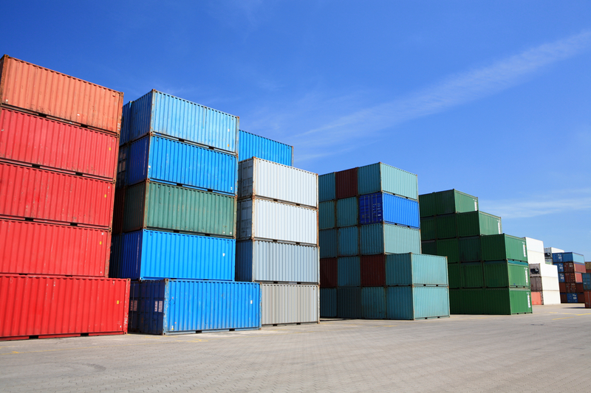
The Evolution of the Shipping Container
In 1956, Malcom McClean invented intermodal shipping, sending the first containers from Newark, N.J. to Houston.
Ports worldwide developed new container ports, followed by material handling equipment for containers.
Today, over 5,500 container ships sail the seas.
Container ships kept getting larger and larger, resulting in upgrades in ports and canals.
More than 80% of the world’s goods are carried by sea – international shipping enables globalization.
Large ports around the world have become centers of commerce and globalization.
11

Slide 63
The Evolution of the Shipping Container
In 1956, Malcom McClean invented intermodal shipping, sending the first containers from Newark, N.J. to Houston.
Ports worldwide developed new container ports, followed by material handling equipment for containers.
Today, over 5,500 container ships sail the seas.
Container ships kept getting larger and larger, resulting in upgrades in ports and canals.
More than 80% of the world’s goods are carried by sea – international shipping enables globalization.
Large ports around the world have become centers of commerce and globalization.
11

Slide 64
The Evolution of the Shipping Container
In 1956, Malcom McClean invented intermodal shipping, sending the first containers from Newark, N.J. to Houston.
Ports worldwide developed new container ports, followed by material handling equipment for containers.
Today, over 5,500 container ships sail the seas.
Container ships kept getting larger and larger, resulting in upgrades in ports and canals.
More than 80% of the world’s goods are carried by sea – international shipping enables globalization.
Large ports around the world have become centers of commerce and globalization.
11

Slide 65
The Evolution of the Shipping Container
In 1956, Malcom McClean invented intermodal shipping, sending the first containers from Newark, N.J. to Houston.
Ports worldwide developed new container ports, followed by material handling equipment for containers.
Today, over 5,500 container ships sail the seas.
Container ships kept getting larger and larger, resulting in upgrades in ports and canals.
More than 80% of the world’s goods are carried by sea – international shipping enables globalization.
Large ports around the world have become centers of commerce and globalization.
11

Slide 66
The Evolution of the Shipping Container
In 1956, Malcom McClean invented intermodal shipping, sending the first containers from Newark, N.J. to Houston.
Ports worldwide developed new container ports, followed by material handling equipment for containers.
Today, over 5,500 container ships sail the seas.
Container ships kept getting larger and larger, resulting in upgrades in ports and canals.
More than 80% of the world’s goods are carried by sea – international shipping enables globalization.
Large ports around the world have become centers of commerce and globalization.
11

Slide 67
The Evolution of the Shipping Container
In 1956, Malcom McClean invented intermodal shipping, sending the first containers from Newark, N.J. to Houston.
Ports worldwide developed new container ports, followed by material handling equipment for containers.
Today, over 5,500 container ships sail the seas.
Container ships kept getting larger and larger, resulting in upgrades in ports and canals.
More than 80% of the world’s goods are carried by sea – international shipping enables globalization.
Large ports around the world have become centers of commerce and globalization.
11

Slide 68
The Evolution of the Shipping Container
In 1956, Malcom McClean invented intermodal shipping, sending the first containers from Newark, N.J. to Houston.
Ports worldwide developed new container ports, followed by material handling equipment for containers.
Today, over 5,500 container ships sail the seas.
Container ships kept getting larger and larger, resulting in upgrades in ports and canals.
More than 80% of the world’s goods are carried by sea – international shipping enables globalization.
Large ports around the world have become centers of commerce and globalization.
11

Slide 69
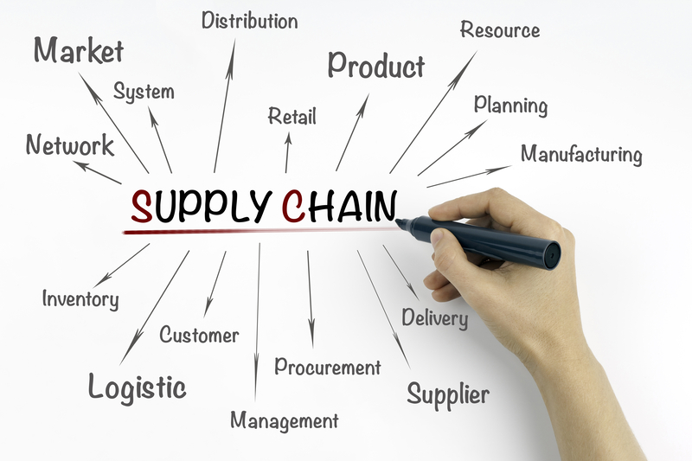
The Evolution of Supply Chain
EERR:
  E = Efficiency: Reduced cost
  E = Effectiveness: Increased revenue
  R = Respect: Grasping importance
  R = Resilience: Responding to VUCA
12

Slide 70
The Evolution of Supply Chain
EERR:
  E = Efficiency: Reduced cost
  E = Effectiveness: Increased revenue
  R = Respect: Grasping importance
  R = Resilience: Responding to VUCA
12

Slide 71
The Evolution of Supply Chain
EERR:
  E = Efficiency: Reduced cost
  E = Effectiveness: Increased revenue
  R = Respect: Grasping importance
  R = Resilience: Responding to VUCA
12

Slide 72
The Evolution of Supply Chain
EERR:
  E = Efficiency: Reduced cost
  E = Effectiveness: Increased revenue
  R = Respect: Grasping importance
  R = Resilience: Responding to VUCA
12

Slide 73
The Evolution of Supply Chain
EERR:
  E = Efficiency: Reduced cost
  E = Effectiveness: Increased revenue
  R = Respect: Grasping importance
  R = Resilience: Responding to VUCA
12

Slide 74
The Evolution of Supply Chain
EERR:
  E = Efficiency: Reduced cost
  E = Effectiveness: Increased revenue
  R = Respect: Grasping importance
  R = Resilience: Responding to VUCA
12

Slide 75

The Evolution of Supply Chain Technology
Digital supply networks will:
  Handle high degrees of complexity,
  Eliminate latency with real-time information,
  Autonomously resolve many problems with artificial intelligence and machine learning,
  Optimize the entire chain, not just specific links,
  Harvest the benefits of internal and external synergies even while facing VUCA and
  Exponentially reduce the cost of goods sold across the dozens, hundreds or thousands of entities that make up your supply chain.
Cybersecurity: Unfriendly countries pose higher cybersecurity risks
13

Slide 76
The Evolution of Supply Chain Technology
Digital supply networks will:
  Handle high degrees of complexity,
  Eliminate latency with real-time information,
  Autonomously resolve many problems with artificial intelligence and machine learning,
  Optimize the entire chain, not just specific links,
  Harvest the benefits of internal and external synergies even while facing VUCA and
  Exponentially reduce the cost of goods sold across the dozens, hundreds or thousands of entities that make up your supply chain.
Cybersecurity: Unfriendly countries pose higher cybersecurity risks
13

Slide 77
The Evolution of Supply Chain Technology
Digital supply networks will:
  Handle high degrees of complexity,
  Eliminate latency with real-time information,
  Autonomously resolve many problems with artificial intelligence and machine learning,
  Optimize the entire chain, not just specific links,
  Harvest the benefits of internal and external synergies even while facing VUCA and
  Exponentially reduce the cost of goods sold across the dozens, hundreds or thousands of entities that make up your supply chain.
Cybersecurity: Unfriendly countries pose higher cybersecurity risks
13

Slide 78
The Evolution of Supply Chain Technology
Digital supply networks will:
  Handle high degrees of complexity,
  Eliminate latency with real-time information,
  Autonomously resolve many problems with artificial intelligence and machine learning,
  Optimize the entire chain, not just specific links,
  Harvest the benefits of internal and external synergies even while facing VUCA and
  Exponentially reduce the cost of goods sold across the dozens, hundreds or thousands of entities that make up your supply chain.
Cybersecurity: Unfriendly countries pose higher cybersecurity risks
13

Slide 79
The Evolution of Supply Chain Technology
Digital supply networks will:
  Handle high degrees of complexity,
  Eliminate latency with real-time information,
  Autonomously resolve many problems with artificial intelligence and machine learning,
  Optimize the entire chain, not just specific links,
  Harvest the benefits of internal and external synergies even while facing VUCA and
  Exponentially reduce the cost of goods sold across the dozens, hundreds or thousands of entities that make up your supply chain.
Cybersecurity: Unfriendly countries pose higher cybersecurity risks
13

Slide 80
The Evolution of Supply Chain Technology
Digital supply networks will:
  Handle high degrees of complexity,
  Eliminate latency with real-time information,
  Autonomously resolve many problems with artificial intelligence and machine learning,
  Optimize the entire chain, not just specific links,
  Harvest the benefits of internal and external synergies even while facing VUCA and
  Exponentially reduce the cost of goods sold across the dozens, hundreds or thousands of entities that make up your supply chain.
Cybersecurity: Unfriendly countries pose higher cybersecurity risks
13

Slide 81
The Evolution of Supply Chain Technology
Digital supply networks will:
  Handle high degrees of complexity,
  Eliminate latency with real-time information,
  Autonomously resolve many problems with artificial intelligence and machine learning,
  Optimize the entire chain, not just specific links,
  Harvest the benefits of internal and external synergies even while facing VUCA and
  Exponentially reduce the cost of goods sold across the dozens, hundreds or thousands of entities that make up your supply chain.
Cybersecurity: Unfriendly countries pose higher cybersecurity risks
13

Slide 82
The Evolution of Supply Chain Technology
Digital supply networks will:
  Handle high degrees of complexity,
  Eliminate latency with real-time information,
  Autonomously resolve many problems with artificial intelligence and machine learning,
  Optimize the entire chain, not just specific links,
  Harvest the benefits of internal and external synergies even while facing VUCA and
  Exponentially reduce the cost of goods sold across the dozens, hundreds or thousands of entities that make up your supply chain.
Cybersecurity: Unfriendly countries pose higher cybersecurity risks
13

Slide 83
The Evolution of Supply Chain Technology
Digital supply networks will:
  Handle high degrees of complexity,
  Eliminate latency with real-time information,
  Autonomously resolve many problems with artificial intelligence and machine learning,
  Optimize the entire chain, not just specific links,
  Harvest the benefits of internal and external synergies even while facing VUCA and
  Exponentially reduce the cost of goods sold across the dozens, hundreds or thousands of entities that make up your supply chain.
Cybersecurity: Unfriendly countries pose higher cybersecurity risks
13

Slide 84
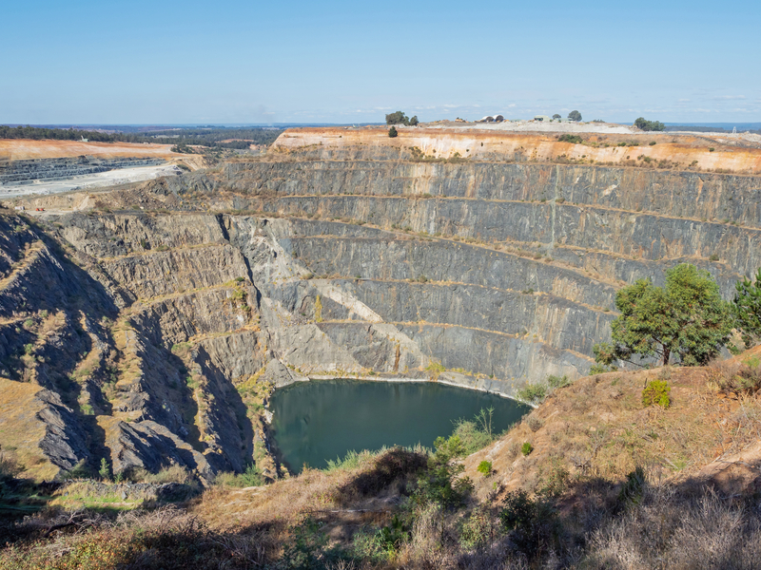
Realigning your Supply Chain for Today’s Globalization Realities: Natural Resources
Sourcing manufactured product from a low-cost country is great. But materials costs are often 10x as important as labor.
In the ranking of countries for value of natural resources: Russia is No. 1, followed by the United States, Saudia Arabia, Canada, Iran and, in 6th place, China.
China, however, leads the world in pursuing access to raw materials.
China is not only the factory of the world but the owner of the supply chain that feeds the factory of the world.
ASEAN (Association of Southeast Nations) has abundant natural resources, low labor costs and friendly relations with the West.
India also has significant mineral resources, as well as a huge home market for goods.
14

Slide 85
Realigning your Supply Chain for Today’s Globalization Realities: Natural Resources
Sourcing manufactured product from a low-cost country is great. But materials costs are often 10x as important as labor.
In the ranking of countries for value of natural resources: Russia is No. 1, followed by the United States, Saudia Arabia, Canada, Iran and, in 6th place, China.
China, however, leads the world in pursuing access to raw materials.
China is not only the factory of the world but the owner of the supply chain that feeds the factory of the world.
ASEAN (Association of Southeast Nations) has abundant natural resources, low labor costs and friendly relations with the West.
India also has significant mineral resources, as well as a huge home market for goods.
14

Slide 86
Realigning your Supply Chain for Today’s Globalization Realities: Natural Resources
Sourcing manufactured product from a low-cost country is great. But materials costs are often 10x as important as labor.
In the ranking of countries for value of natural resources: Russia is No. 1, followed by the United States, Saudia Arabia, Canada, Iran and, in 6th place, China.
China, however, leads the world in pursuing access to raw materials.
China is not only the factory of the world but the owner of the supply chain that feeds the factory of the world.
ASEAN (Association of Southeast Nations) has abundant natural resources, low labor costs and friendly relations with the West.
India also has significant mineral resources, as well as a huge home market for goods.
14

Slide 87
Realigning your Supply Chain for Today’s Globalization Realities: Natural Resources
Sourcing manufactured product from a low-cost country is great. But materials costs are often 10x as important as labor.
In the ranking of countries for value of natural resources: Russia is No. 1, followed by the United States, Saudia Arabia, Canada, Iran and, in 6th place, China.
China, however, leads the world in pursuing access to raw materials.
China is not only the factory of the world but the owner of the supply chain that feeds the factory of the world.
ASEAN (Association of Southeast Nations) has abundant natural resources, low labor costs and friendly relations with the West.
India also has significant mineral resources, as well as a huge home market for goods.
14

Slide 88
Realigning your Supply Chain for Today’s Globalization Realities: Natural Resources
Sourcing manufactured product from a low-cost country is great. But materials costs are often 10x as important as labor.
In the ranking of countries for value of natural resources: Russia is No. 1, followed by the United States, Saudia Arabia, Canada, Iran and, in 6th place, China.
China, however, leads the world in pursuing access to raw materials.
China is not only the factory of the world but the owner of the supply chain that feeds the factory of the world.
ASEAN (Association of Southeast Nations) has abundant natural resources, low labor costs and friendly relations with the West.
India also has significant mineral resources, as well as a huge home market for goods.
14

Slide 89
Realigning your Supply Chain for Today’s Globalization Realities: Natural Resources
Sourcing manufactured product from a low-cost country is great. But materials costs are often 10x as important as labor.
In the ranking of countries for value of natural resources: Russia is No. 1, followed by the United States, Saudia Arabia, Canada, Iran and, in 6th place, China.
China, however, leads the world in pursuing access to raw materials.
China is not only the factory of the world but the owner of the supply chain that feeds the factory of the world.
ASEAN (Association of Southeast Nations) has abundant natural resources, low labor costs and friendly relations with the West.
India also has significant mineral resources, as well as a huge home market for goods.
14

Slide 90
Realigning your Supply Chain for Today’s Globalization Realities: Natural Resources
Sourcing manufactured product from a low-cost country is great. But materials costs are often 10x as important as labor.
In the ranking of countries for value of natural resources: Russia is No. 1, followed by the United States, Saudia Arabia, Canada, Iran and, in 6th place, China.
China, however, leads the world in pursuing access to raw materials.
China is not only the factory of the world but the owner of the supply chain that feeds the factory of the world.
ASEAN (Association of Southeast Nations) has abundant natural resources, low labor costs and friendly relations with the West.
India also has significant mineral resources, as well as a huge home market for goods.
14

Slide 91
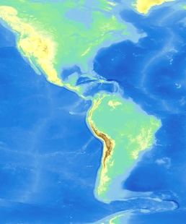
Realigning your Supply Chain for Today’s Globalization Realities: Sourcing
Supply chains that are closer to the United States (Brazil, Latin American and Caribbean countries) offer attractive sourcing alternatives.
Reduced freight costs and lead times are extremely important, both for the Western Hemisphere and from Africa for the European market.
Reshoring to the United States and Europe offers interesting potential for products where automation can replace labor.
Europe, Latin America and the Caribbean offer higher proportions of emissions-free energy (nuclear, hydro, wind and solar)
When cost was king, single sourcing was king. Now when resilience is king, multiple sourcing has become the more prudent approach.
The Dominican Republic is becoming to the Western Hemisphere what Singapore is to the Eastern Hemisphere and what Rotterdam is to Europe.
15

Slide 92
Realigning your Supply Chain for Today’s Globalization Realities: Sourcing
Supply chains that are closer to the United States (Brazil, Latin American and Caribbean countries) offer attractive sourcing alternatives.
Reduced freight costs and lead times are extremely important, both for the Western Hemisphere and from Africa for the European market.
Reshoring to the United States and Europe offers interesting potential for products where automation can replace labor.
Europe, Latin America and the Caribbean offer higher proportions of emissions-free energy (nuclear, hydro, wind and solar)
When cost was king, single sourcing was king. Now when resilience is king, multiple sourcing has become the more prudent approach.
The Dominican Republic is becoming to the Western Hemisphere what Singapore is to the Eastern Hemisphere and what Rotterdam is to Europe.
15

Slide 93
Realigning your Supply Chain for Today’s Globalization Realities: Sourcing
Supply chains that are closer to the United States (Brazil, Latin American and Caribbean countries) offer attractive sourcing alternatives.
Reduced freight costs and lead times are extremely important, both for the Western Hemisphere and from Africa for the European market.
Reshoring to the United States and Europe offers interesting potential for products where automation can replace labor.
Europe, Latin America and the Caribbean offer higher proportions of emissions-free energy (nuclear, hydro, wind and solar)
When cost was king, single sourcing was king. Now when resilience is king, multiple sourcing has become the more prudent approach.
The Dominican Republic is becoming to the Western Hemisphere what Singapore is to the Eastern Hemisphere and what Rotterdam is to Europe.
15

Slide 94
Realigning your Supply Chain for Today’s Globalization Realities: Sourcing
Supply chains that are closer to the United States (Brazil, Latin American and Caribbean countries) offer attractive sourcing alternatives.
Reduced freight costs and lead times are extremely important, both for the Western Hemisphere and from Africa for the European market.
Reshoring to the United States and Europe offers interesting potential for products where automation can replace labor.
Europe, Latin America and the Caribbean offer higher proportions of emissions-free energy (nuclear, hydro, wind and solar)
When cost was king, single sourcing was king. Now when resilience is king, multiple sourcing has become the more prudent approach.
The Dominican Republic is becoming to the Western Hemisphere what Singapore is to the Eastern Hemisphere and what Rotterdam is to Europe.
15

Slide 95
Realigning your Supply Chain for Today’s Globalization Realities: Sourcing
Supply chains that are closer to the United States (Brazil, Latin American and Caribbean countries) offer attractive sourcing alternatives.
Reduced freight costs and lead times are extremely important, both for the Western Hemisphere and from Africa for the European market.
Reshoring to the United States and Europe offers interesting potential for products where automation can replace labor.
Europe, Latin America and the Caribbean offer higher proportions of emissions-free energy (nuclear, hydro, wind and solar)
When cost was king, single sourcing was king. Now when resilience is king, multiple sourcing has become the more prudent approach.
The Dominican Republic is becoming to the Western Hemisphere what Singapore is to the Eastern Hemisphere and what Rotterdam is to Europe.
15

Slide 96
Realigning your Supply Chain for Today’s Globalization Realities: Sourcing
Supply chains that are closer to the United States (Brazil, Latin American and Caribbean countries) offer attractive sourcing alternatives.
Reduced freight costs and lead times are extremely important, both for the Western Hemisphere and from Africa for the European market.
Reshoring to the United States and Europe offers interesting potential for products where automation can replace labor.
Europe, Latin America and the Caribbean offer higher proportions of emissions-free energy (nuclear, hydro, wind and solar)
When cost was king, single sourcing was king. Now when resilience is king, multiple sourcing has become the more prudent approach.
The Dominican Republic is becoming to the Western Hemisphere what Singapore is to the Eastern Hemisphere and what Rotterdam is to Europe.
15

Slide 97
Realigning your Supply Chain for Today’s Globalization Realities: Sourcing
Supply chains that are closer to the United States (Brazil, Latin American and Caribbean countries) offer attractive sourcing alternatives.
Reduced freight costs and lead times are extremely important, both for the Western Hemisphere and from Africa for the European market.
Reshoring to the United States and Europe offers interesting potential for products where automation can replace labor.
Europe, Latin America and the Caribbean offer higher proportions of emissions-free energy (nuclear, hydro, wind and solar)
When cost was king, single sourcing was king. Now when resilience is king, multiple sourcing has become the more prudent approach.
The Dominican Republic is becoming to the Western Hemisphere what Singapore is to the Eastern Hemisphere and what Rotterdam is to Europe.
15

Slide 98
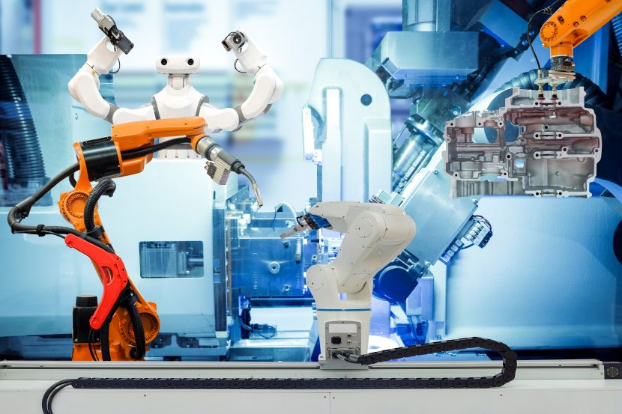
Realigning your Supply Chain for Today’s Globalization Realities: Labor
Labor cost is an important factor, but so too are several other factors:
  Workforce availability, productivity, knowledge and training,
  Experience of workers with technology, automation and robotics and
  Respect of workers and avoiding forced labor, inhumane working conditions, human rights violations, child labor, etc.
Consumer perception over how employers treat their workforce has a major impact on a brand’s overall reputation.
ESG is a big deal.
It’s not about office/home/hybrid, it is about trust and inspire, family-friendly workplaces and adaptability.
16

Slide 99
Realigning your Supply Chain for Today’s Globalization Realities: Labor
Labor cost is an important factor, but so too are several other factors:
  Workforce availability, productivity, knowledge and training,
  Experience of workers with technology, automation and robotics and
  Respect of workers and avoiding forced labor, inhumane working conditions, human rights violations, child labor, etc.
Consumer perception over how employers treat their workforce has a major impact on a brand’s overall reputation.
ESG is a big deal.
It’s not about office/home/hybrid, it is about trust and inspire, family-friendly workplaces and adaptability.
16

Slide 100
Realigning your Supply Chain for Today’s Globalization Realities: Labor
Labor cost is an important factor, but so too are several other factors:
  Workforce availability, productivity, knowledge and training,
  Experience of workers with technology, automation and robotics and
  Respect of workers and avoiding forced labor, inhumane working conditions, human rights violations, child labor, etc.
Consumer perception over how employers treat their workforce has a major impact on a brand’s overall reputation.
ESG is a big deal.
It’s not about office/home/hybrid, it is about trust and inspire, family-friendly workplaces and adaptability.
16

Slide 101
Realigning your Supply Chain for Today’s Globalization Realities: Labor
Labor cost is an important factor, but so too are several other factors:
  Workforce availability, productivity, knowledge and training,
  Experience of workers with technology, automation and robotics and
  Respect of workers and avoiding forced labor, inhumane working conditions, human rights violations, child labor, etc.
Consumer perception over how employers treat their workforce has a major impact on a brand’s overall reputation.
ESG is a big deal.
It’s not about office/home/hybrid, it is about trust and inspire, family-friendly workplaces and adaptability.
16

Slide 102
Realigning your Supply Chain for Today’s Globalization Realities: Labor
Labor cost is an important factor, but so too are several other factors:
  Workforce availability, productivity, knowledge and training,
  Experience of workers with technology, automation and robotics and
  Respect of workers and avoiding forced labor, inhumane working conditions, human rights violations, child labor, etc.
Consumer perception over how employers treat their workforce has a major impact on a brand’s overall reputation.
ESG is a big deal.
It’s not about office/home/hybrid, it is about trust and inspire, family-friendly workplaces and adaptability.
16

Slide 103
Realigning your Supply Chain for Today’s Globalization Realities: Labor
Labor cost is an important factor, but so too are several other factors:
  Workforce availability, productivity, knowledge and training,
  Experience of workers with technology, automation and robotics and
  Respect of workers and avoiding forced labor, inhumane working conditions, human rights violations, child labor, etc.
Consumer perception over how employers treat their workforce has a major impact on a brand’s overall reputation.
ESG is a big deal.
It’s not about office/home/hybrid, it is about trust and inspire, family-friendly workplaces and adaptability.
16

Slide 104
Realigning your Supply Chain for Today’s Globalization Realities: Labor
Labor cost is an important factor, but so too are several other factors:
  Workforce availability, productivity, knowledge and training,
  Experience of workers with technology, automation and robotics and
  Respect of workers and avoiding forced labor, inhumane working conditions, human rights violations, child labor, etc.
Consumer perception over how employers treat their workforce has a major impact on a brand’s overall reputation.
ESG is a big deal.
It’s not about office/home/hybrid, it is about trust and inspire, family-friendly workplaces and adaptability.
16

Slide 105
Realigning your Supply Chain for Today’s Globalization Realities: Labor
Labor cost is an important factor, but so too are several other factors:
  Workforce availability, productivity, knowledge and training,
  Experience of workers with technology, automation and robotics and
  Respect of workers and avoiding forced labor, inhumane working conditions, human rights violations, child labor, etc.
Consumer perception over how employers treat their workforce has a major impact on a brand’s overall reputation.
ESG is a big deal.
It’s not about office/home/hybrid, it is about trust and inspire, family-friendly workplaces and adaptability.
16

Slide 106
Path Forward: Maneuvering an Uneven Playing Field
Prior to the 1960s, China was a non-player in world trade, but they progressed from 30th place in 1960 to 15th place in 1980, 6th place in 2000 and 2nd in 2020.
But China’s state capitalism does not adhere to free trade, ESG nor a level playing field.
China has a “special relationship” with Russia, is a threat to Taiwan and Globalization.
A balance between resilience and cost is required for companies to be successful. Successful organizations will alter their sourcing strategy to support Globalization.
Altering a company’s sourcing strategy requires the company to alter their supply chain and their logistics strategy.
17

Slide 107
Path Forward: Maneuvering an Uneven Playing Field
Prior to the 1960s, China was a non-player in world trade, but they progressed from 30th place in 1960 to 15th place in 1980, 6th place in 2000 and 2nd in 2020.
But China’s state capitalism does not adhere to free trade, ESG nor a level playing field.
China has a “special relationship” with Russia, is a threat to Taiwan and Globalization.
A balance between resilience and cost is required for companies to be successful. Successful organizations will alter their sourcing strategy to support Globalization.
Altering a company’s sourcing strategy requires the company to alter their supply chain and their logistics strategy.
17

Slide 108
Path Forward: Maneuvering an Uneven Playing Field
Prior to the 1960s, China was a non-player in world trade, but they progressed from 30th place in 1960 to 15th place in 1980, 6th place in 2000 and 2nd in 2020.
But China’s state capitalism does not adhere to free trade, ESG nor a level playing field.
China has a “special relationship” with Russia, is a threat to Taiwan and Globalization.
A balance between resilience and cost is required for companies to be successful. Successful organizations will alter their sourcing strategy to support Globalization.
Altering a company’s sourcing strategy requires the company to alter their supply chain and their logistics strategy.
17

Slide 109
Path Forward: Maneuvering an Uneven Playing Field
Prior to the 1960s, China was a non-player in world trade, but they progressed from 30th place in 1960 to 15th place in 1980, 6th place in 2000 and 2nd in 2020.
But China’s state capitalism does not adhere to free trade, ESG nor a level playing field.
China has a “special relationship” with Russia, is a threat to Taiwan and Globalization.
A balance between resilience and cost is required for companies to be successful. Successful organizations will alter their sourcing strategy to support Globalization.
Altering a company’s sourcing strategy requires the company to alter their supply chain and their logistics strategy.
17

Slide 110
Path Forward: Maneuvering an Uneven Playing Field
Prior to the 1960s, China was a non-player in world trade, but they progressed from 30th place in 1960 to 15th place in 1980, 6th place in 2000 and 2nd in 2020.
But China’s state capitalism does not adhere to free trade, ESG nor a level playing field.
China has a “special relationship” with Russia, is a threat to Taiwan and Globalization.
A balance between resilience and cost is required for companies to be successful. Successful organizations will alter their sourcing strategy to support Globalization.
Altering a company’s sourcing strategy requires the company to alter their supply chain and their logistics strategy.
17

Slide 111
Path Forward: Maneuvering an Uneven Playing Field
Prior to the 1960s, China was a non-player in world trade, but they progressed from 30th place in 1960 to 15th place in 1980, 6th place in 2000 and 2nd in 2020.
But China’s state capitalism does not adhere to free trade, ESG nor a level playing field.
China has a “special relationship” with Russia, is a threat to Taiwan and Globalization.
A balance between resilience and cost is required for companies to be successful. Successful organizations will alter their sourcing strategy to support Globalization.
Altering a company’s sourcing strategy requires the company to alter their supply chain and their logistics strategy.
17

Slide 112
In Conclusion
Globalization and Deglobalization are Yin and Yang – complementary, interconnected and interdependent.
It ain’t about your grandfather’s supply chain; it’s a whole new thing: Globalization.
It ain’t about your grandfather’s village; it’s a whole new thing: Globalization.
You must adopt:
  Globalization,
  Resilience,
  ESG,
  Circular Economy,
  Family Friendly Workplaces and
  New Sourcing, Transportation, Distribution/Fulfillment and Supply Chain Technology
18

Slide 113
In Conclusion
Globalization and Deglobalization are Yin and Yang – complementary, interconnected and interdependent.
It ain’t about your grandfather’s supply chain; it’s a whole new thing: Globalization.
It ain’t about your grandfather’s village; it’s a whole new thing: Globalization.
You must adopt:
  Globalization,
  Resilience,
  ESG,
  Circular Economy,
  Family Friendly Workplaces and
  New Sourcing, Transportation, Distribution/Fulfillment and Supply Chain Technology
113

Slide 114
In Conclusion
Globalization and Deglobalization are Yin and Yang – complementary, interconnected and interdependent.
It ain’t about your grandfather’s supply chain; it’s a whole new thing: Globalization.
It ain’t about your grandfather’s village; it’s a whole new thing: Globalization.
You must adopt:
  Globalization,
  Resilience,
  ESG,
  Circular Economy,
  Family Friendly Workplaces and
  New Sourcing, Transportation, Distribution/Fulfillment and Supply Chain Technology
114

Slide 115
In Conclusion
Globalization and Deglobalization are Yin and Yang – complementary, interconnected and interdependent.
It ain’t about your grandfather’s supply chain; it’s a whole new thing: Globalization.
It ain’t about your grandfather’s village; it’s a whole new thing: Globalization.
You must adopt:
  Globalization,
  Resilience,
  ESG,
  Circular Economy,
  Family Friendly Workplaces and
  New Sourcing, Transportation, Distribution/Fulfillment and Supply Chain Technology
115

Slide 116
In Conclusion
Globalization and Deglobalization are Yin and Yang – complementary, interconnected and interdependent.
It ain’t about your grandfather’s supply chain; it’s a whole new thing: Globalization.
It ain’t about your grandfather’s village; it’s a whole new thing: Globalization.
You must adopt:
  Globalization,
  Resilience,
  ESG,
  Circular Economy,
  Family Friendly Workplaces and
  New Sourcing, Transportation, Distribution/Fulfillment and Supply Chain Technology
116

Slide 117
In Conclusion
Globalization and Deglobalization are Yin and Yang – complementary, interconnected and interdependent.
It ain’t about your grandfather’s supply chain; it’s a whole new thing: Globalization.
It ain’t about your grandfather’s village; it’s a whole new thing: Globalization.
You must adopt:
  Globalization,
  Resilience,
  ESG,
  Circular Economy,
  Family Friendly Workplaces and
  New Sourcing, Transportation, Distribution/Fulfillment and Supply Chain Technology
117

Slide 118
In Conclusion
Globalization and Deglobalization are Yin and Yang – complementary, interconnected and interdependent.
It ain’t about your grandfather’s supply chain; it’s a whole new thing: Globalization.
It ain’t about your grandfather’s village; it’s a whole new thing: Globalization.
You must adopt:
  Globalization,
  Resilience,
  ESG,
  Circular Economy,
  Family Friendly Workplaces and
  New Sourcing, Transportation, Distribution/Fulfillment and Supply Chain Technology
118

Slide 119
In Conclusion
Globalization and Deglobalization are Yin and Yang – complementary, interconnected and interdependent.
It ain’t about your grandfather’s supply chain; it’s a whole new thing: Globalization.
It ain’t about your grandfather’s village; it’s a whole new thing: Globalization.
You must adopt:
  Globalization,
  Resilience,
  ESG,
  Circular Economy,
  Family Friendly Workplaces and
  New Sourcing, Transportation, Distribution/Fulfillment and Supply Chain Technology
119

Slide 120
In Conclusion
Globalization and Deglobalization are Yin and Yang – complementary, interconnected and interdependent.
It ain’t about your grandfather’s supply chain; it’s a whole new thing: Globalization.
It ain’t about your grandfather’s village; it’s a whole new thing: Globalization.
You must adopt:
  Globalization,
  Resilience,
  ESG,
  Circular Economy,
  Family Friendly Workplaces and
  New Sourcing, Transportation, Distribution/Fulfillment and Supply Chain Technology
120

Slide 121
In Conclusion
Globalization and Deglobalization are Yin and Yang – complementary, interconnected and interdependent.
It ain’t about your grandfather’s supply chain; it’s a whole new thing: Globalization.
It ain’t about your grandfather’s village; it’s a whole new thing: Globalization.
You must adopt:
  Globalization,
  Resilience,
  ESG,
  Circular Economy,
  Family Friendly Workplaces and
  New Sourcing, Transportation, Distribution/Fulfillment and Supply Chain Technology
121

Slide 122
In Conclusion
Globalization and Deglobalization are Yin and Yang – complementary, interconnected and interdependent.
It ain’t about your grandfather’s supply chain; it’s a whole new thing: Globalization.
It ain’t about your grandfather’s village; it’s a whole new thing: Globalization.
You must adopt:
  Globalization,
  Resilience,
  ESG,
  Circular Economy,
  Family Friendly Workplaces and
  New Sourcing, Transportation, Distribution/Fulfillment and Supply Chain Technology
122

Slide 123
White Paper
“The World Is Flat, Except When It Isn’t: The Yin and Yang of Globalization and Deglobalization”
Ny newest white paper helps you understand the future of global trade – and succeed. For 40-plus years, I have designed supply chains for companies ranging from Fortune 500s to startups. See below to download a copy:
https://tompkinsventures.com/insights/globalization-deglobalization-white-paper
123

